Slide 1
Exploring the ‘esquisse’ package in R for data visualization
HARUG
2024-10-17

Slide 2
What is the Esquisse package?
Translates to ‘sketch’
Interactively explore your data with ggplot2 visualizations
User friendly-interface
Produces R code
Can help with learning ggplot2

Slide 3
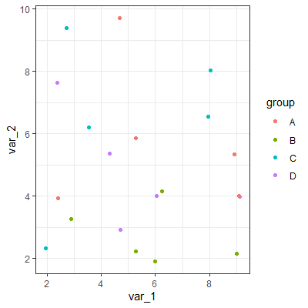
What is ggplot2?
ggplot(data,
aes(x = var_1, y = var_2, color = group)) +
geom_point() +
theme_bw()

Slide 4
Grammar of Graphics
Framework
Layered approach
Descirbe and construct visualisations

Slide 5
Grammar of Graphics
Coordinate system
Cartesian, polar?
Facets
Create subplots based on multiple dimensions
Statistics
Mean, quantiles, confidence interval?
Geometric objects
Line, bar, points?
Scale
Scale values, represent multiple values
Aesthetics
Axes, plot positions, encodings?
Data
Our dataset

Slide 6
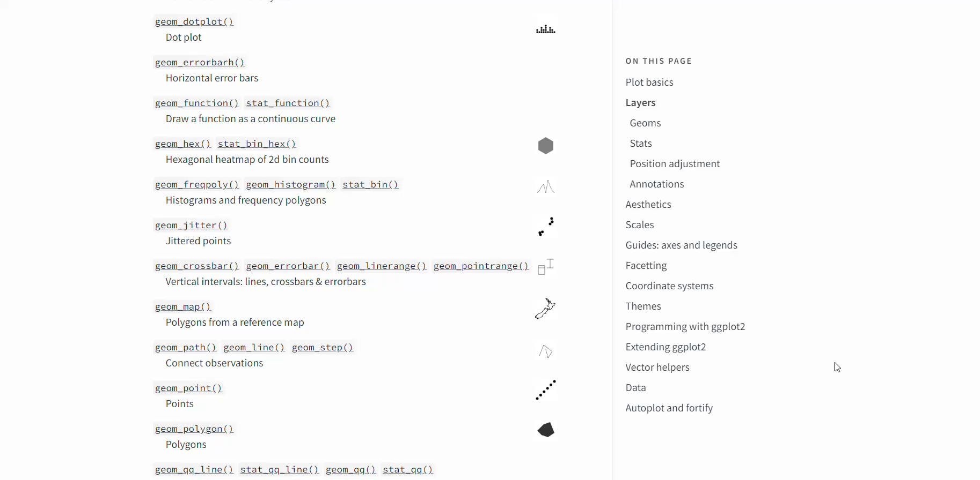
A lot of options for ggplot…

Slide 7
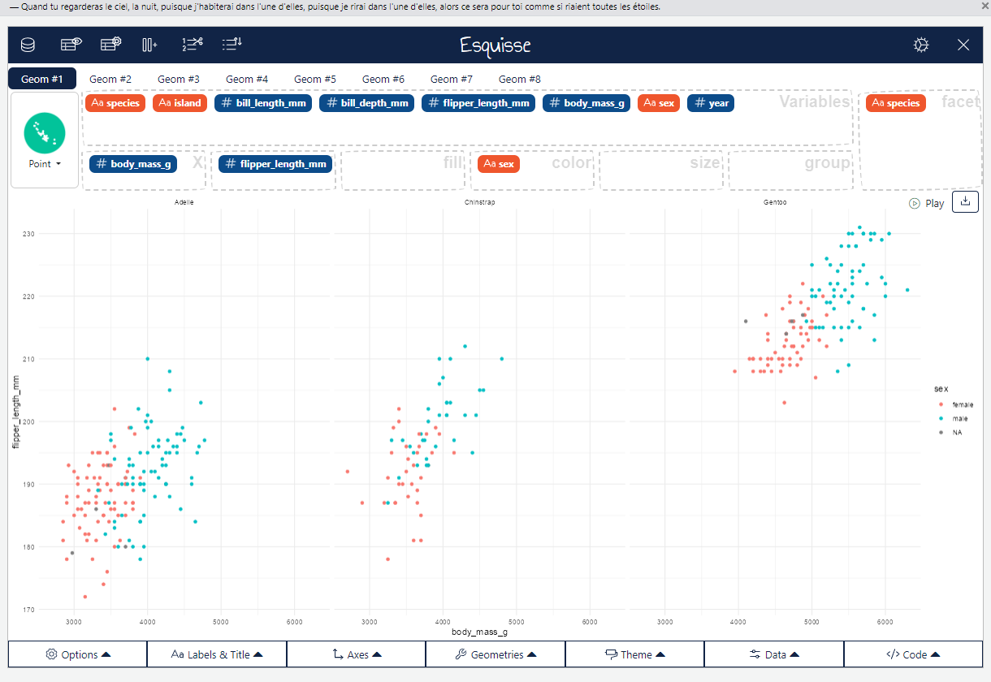
Esquisse demo

